Slide 1

Strategic Acquisition Analysis
Unlocking Value and Enhancing Performance in the Loan Portfolio

Slide 2

Agenda:
Introduction
Assumption
Methodology
Current Portfolio Value Assessment
Portfolio Risk Assessment
Strategic Analysis of Portfolio Profitability
Projected Net Credit Margin Analysis
Strategic Loan Portfolio Optimization
Critical Information Needs for Informed Decision-Making
Market Condition Sensitivity Analysis
Risk Assessment

Slide 3

Introduction
Objective:
The objective was to thoroughly assess the target company's portfolio, determine its value, and outline a roadmap for future success.
Tasks:
The tasks set before me included calculating the current value of the loan portfolio, understanding the associated risks, evaluating the portfolio's quality and performance, and forecasting its future trajectory.
Content:
As we delve into the analysis, I will walk you through the intricacies of our valuation methodology, highlight the qualitative risks that were considered, and share insights on how we envision optimizing the loan portfolio for sustained profitability.
So, without further ado, let's embark on this journey of financial exploration, aiming not just to acquire a lending company but to strategically position ourselves for long-term success in the dynamic world of digital lending

Slide 4
Assumptions:
We assumed a constant remaining repayment term due to limited input data. This led to the assumption of Constant interest income, over a certain period as the principal outstanding was considered static.
Adopted a 5-year book life for the calculation of monthly expected losses.
In our business analysis, We have taken the approach of assuming a linear distribution for expected losses over time. This choice aims to provide a systematic and evenly spread projection of anticipated losses throughout the lifespan of our loan portfolio.
We assume that the value of the business is equivalent to the value of the loan book. Additionally, we operate under the assumption that the entire acquisition can be financed using 100% debt at an annual cost of 8%.
The company's operating expenses, which are the costs associated with running its operations, are estimated to be 2% of the outstanding loan receivables.

Slide 5
Methodology:
Current Value of Portfolio:
The value has been calculated based on Net Asset Value method Combines with Annuity Factor that allows us to discount the future cash flows back to their present value using a discount rate.
Net Credit Margin:
It is calculated as the difference between the interest income generated from the outstanding loan portfolio and the total costs associated with financing ,operations and expected losses
Monthly Interest Receivable:
The interest income by leveraging the product of the average outstanding balance (POS) and the monthly interest rate, which is obtained by dividing the annual interest rate by 12.
Default Rate:
The default percentage reflects the overall default rate over the past two years based on customer delinquency data.

Slide 6
Current Value Portfolio Assessment:
Current Value of Portfolio: Net Asset/ Annuity Factor
Net Asset = Total Asset/ Total Expenses
Annuity Factor: It Calculate the present value of a series of equal cash flows occurring at regular intervals over a specified period and below are the inputs:
Cost of Capital per month: 0.08%
Life of Book: 60 Month
The Current Worth of the Portfolio is: 170582$

Slide 7
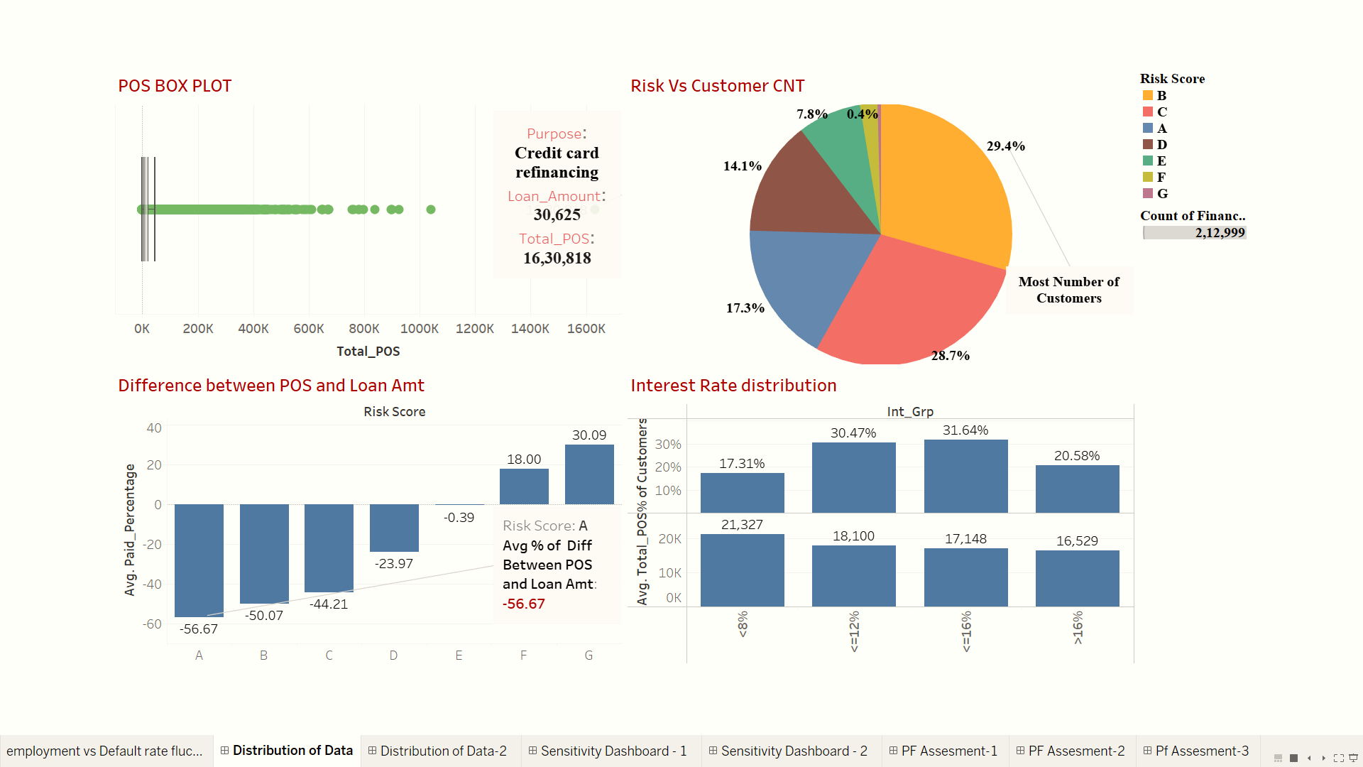
Portfolio Risk Assessment: Unveiling Patterns and Distribution Across Variables

Slide 8
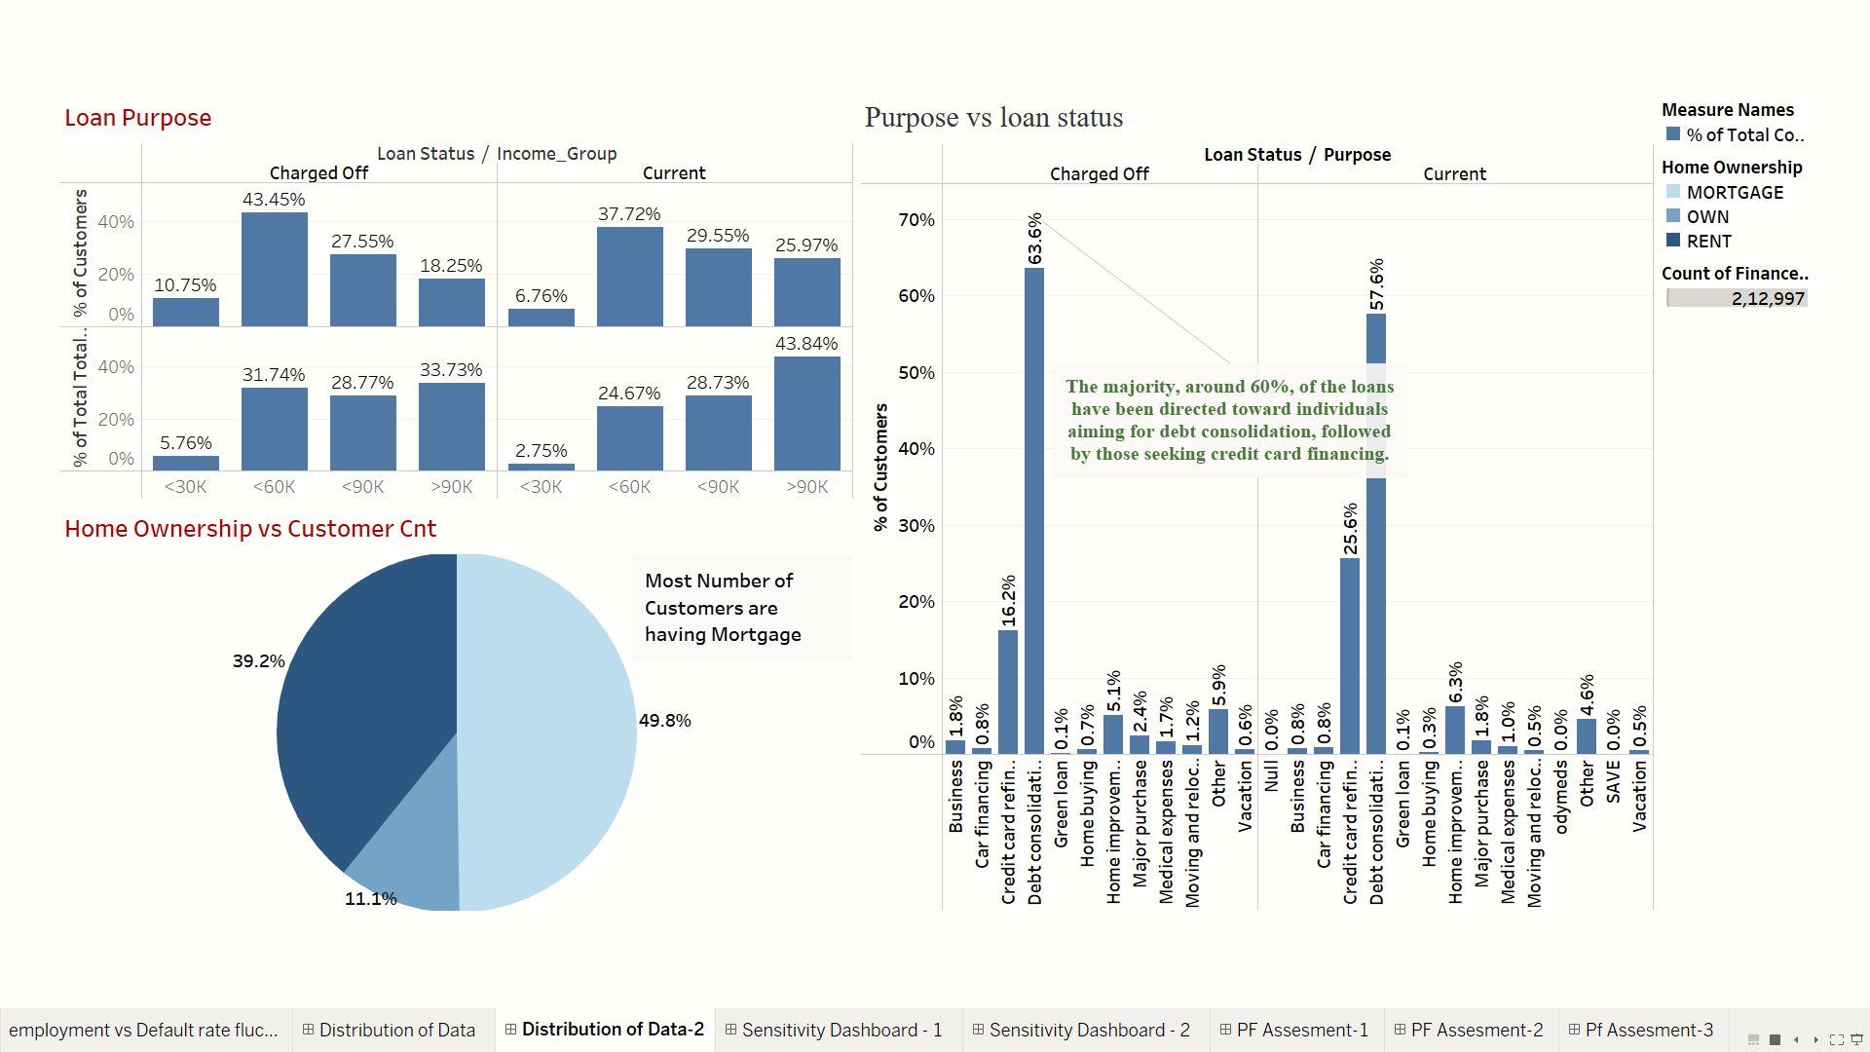
Portfolio Risk Assessment: Unveiling Patterns and Distribution Across Variables
Accounts with earnings between 30k and 60k experience higher charge-offs, while individuals earning more than 90k exhibit a higher outstanding principal.

Slide 9
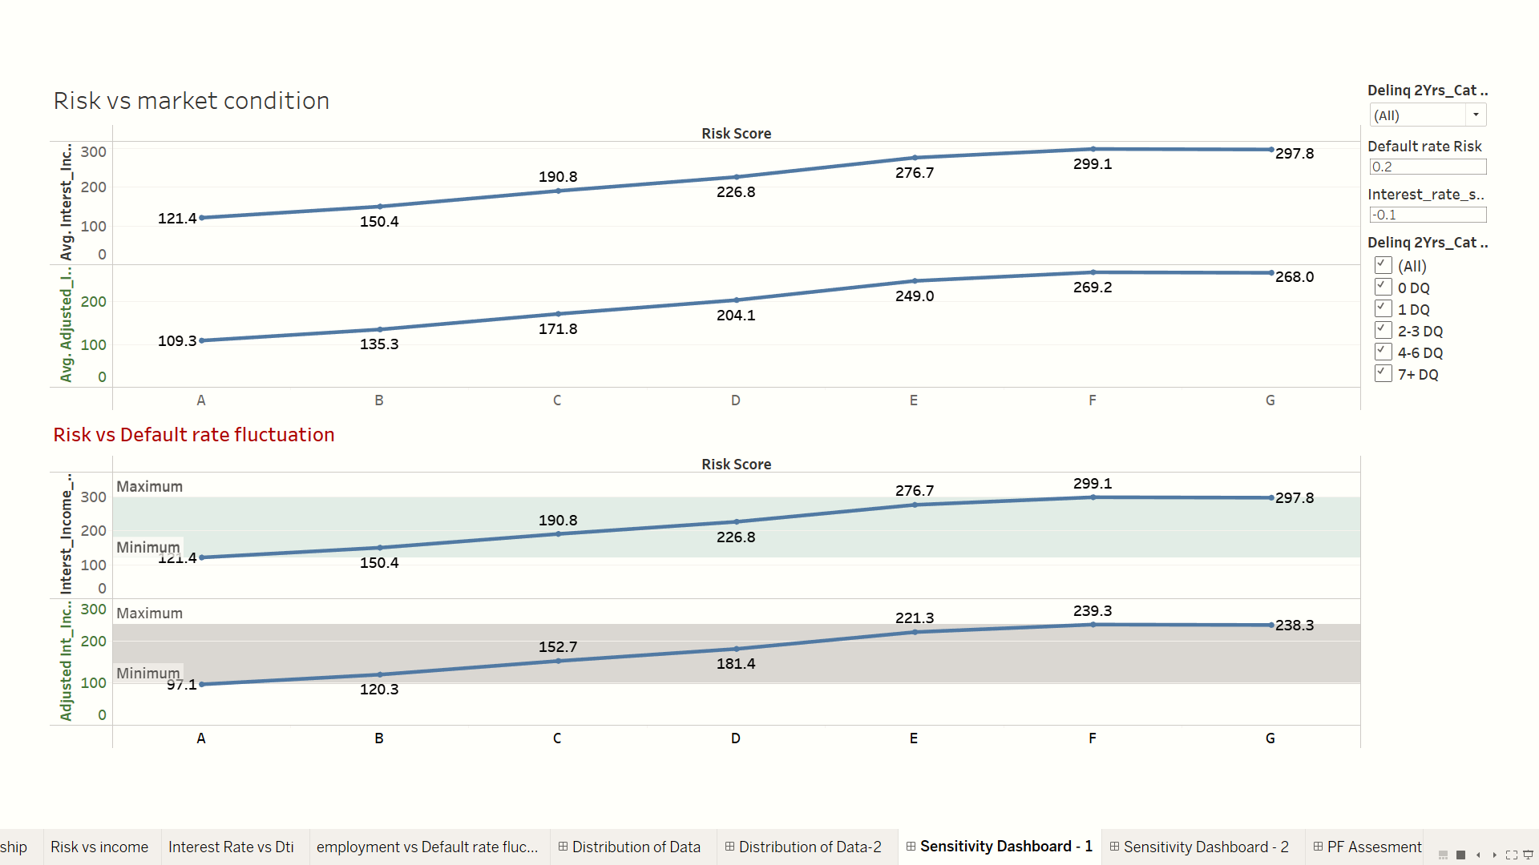
Risk Landscape: Qualitative Overview of Portfolio Vulnerabilities
Increase in Market Interest Rate and Avg Default Rate
A stress analysis, considering a risk range of -15 percent to +15 percent due to fluctuations in market interest rates, indicates that certain risk groups are more impacted than others.
Concurrently, it is noteworthy that Risk Score A shows resilience, with no significant decline when the portfolio is subjected to a 10% risk.
Individuals categorized under Risk Scores E, F, and G are more susceptible to a rise in the default rate.

Slide 10
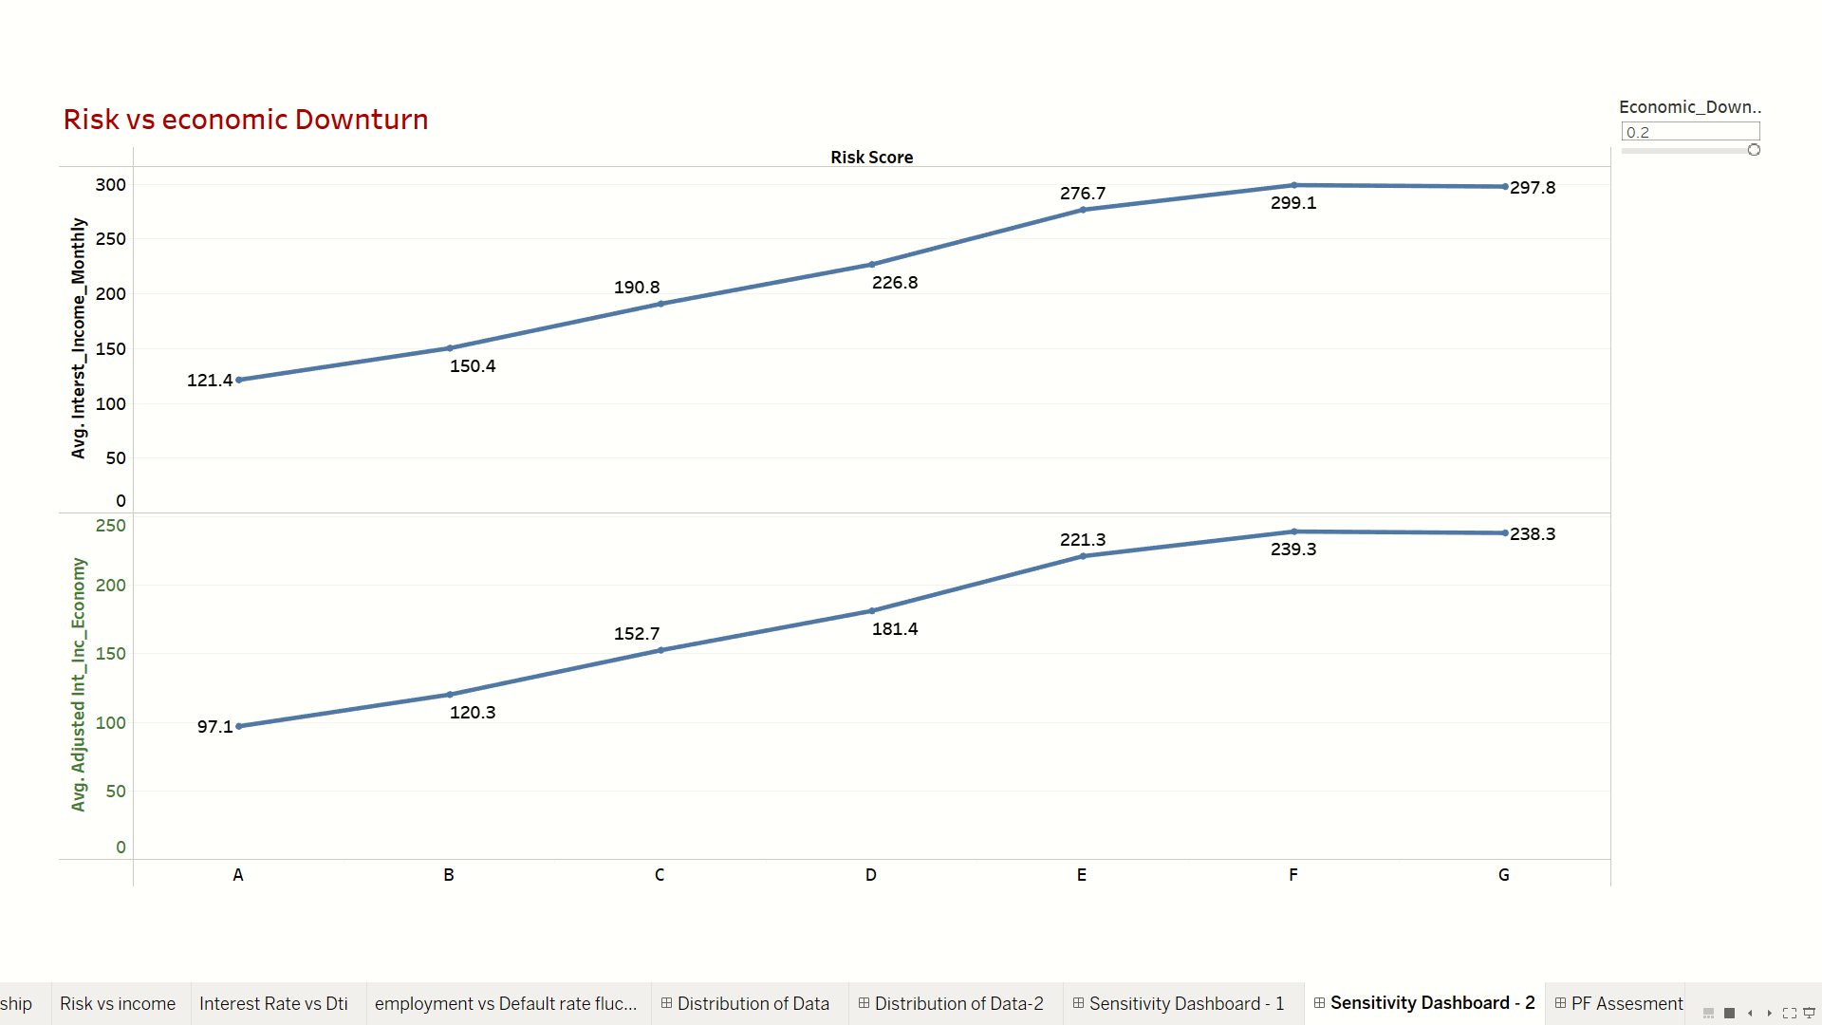
Risk Landscape: Qualitative Overview of Portfolio Vulnerabilities
Economic Downturn:
We aim to simulate a scenario envisioning an economic downturn characterized by factors. In this simulation, We employ a stress level of 0.2, indicating a 20% increase in volatility or risk.
Notably, we observe an adverse impact on the interest income generated by customers classified under Risk Scores C and D during this challenging scenario.

Slide 11
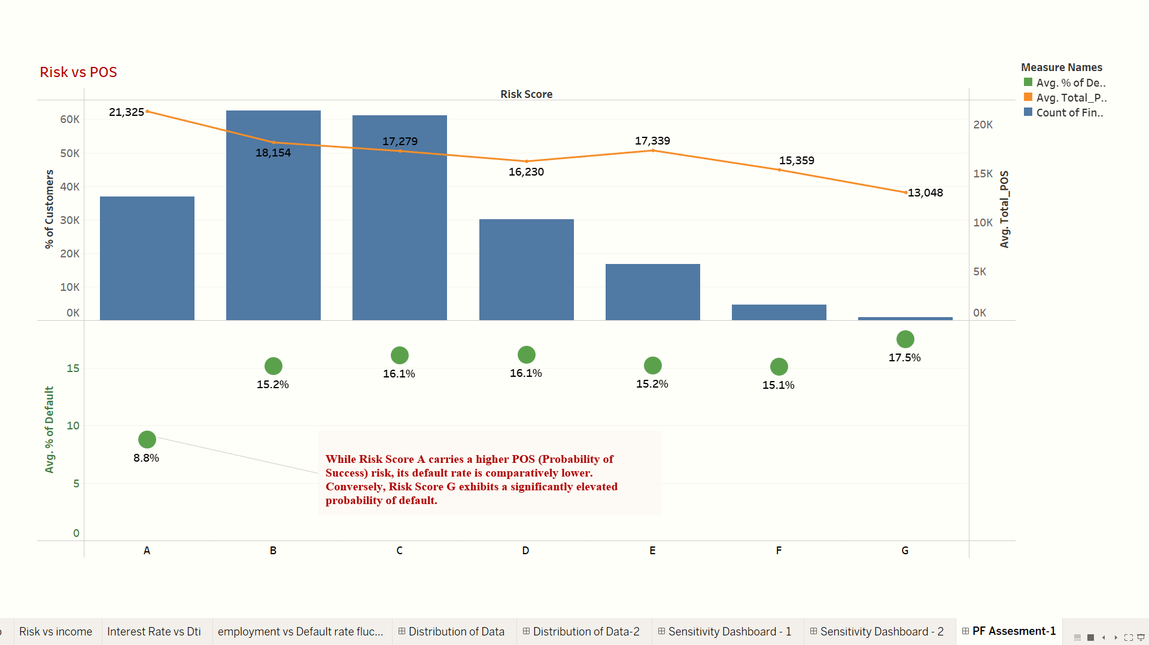
Portfolio health check: evaluating quality and performance metrics

Slide 12
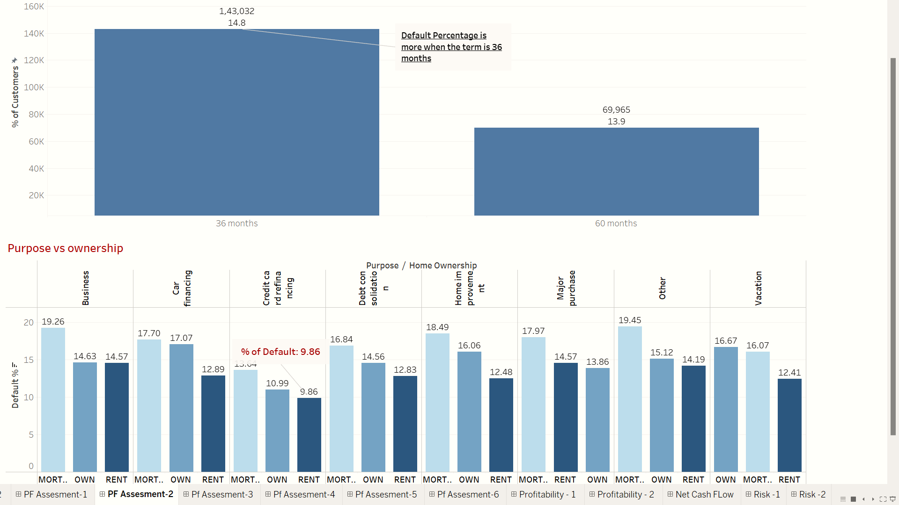
Portfolio health check: evaluating quality and performance metrics

Slide 13
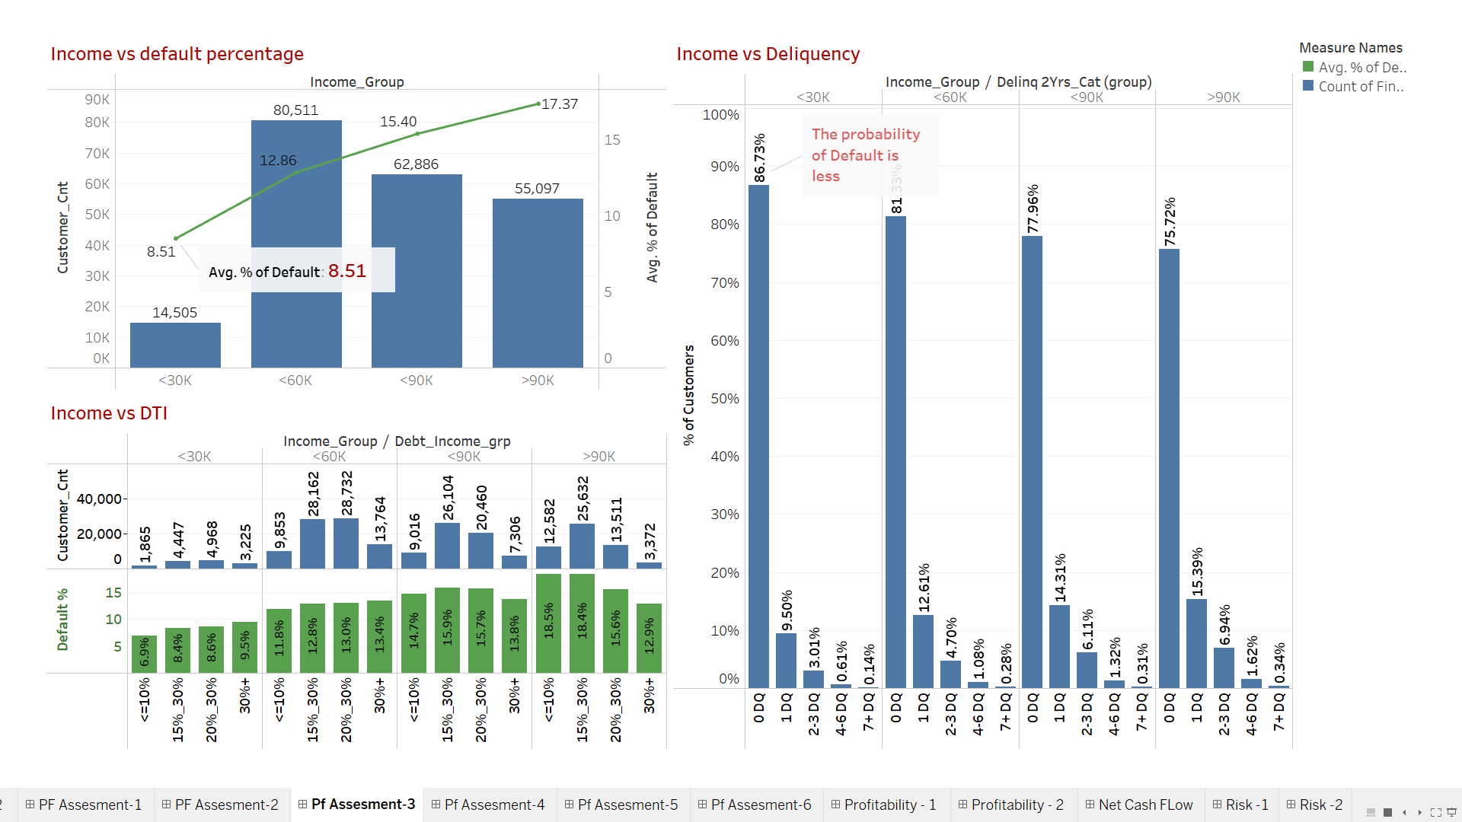
Portfolio Health Check: Evaluating Quality and Performance Metrics

Slide 14
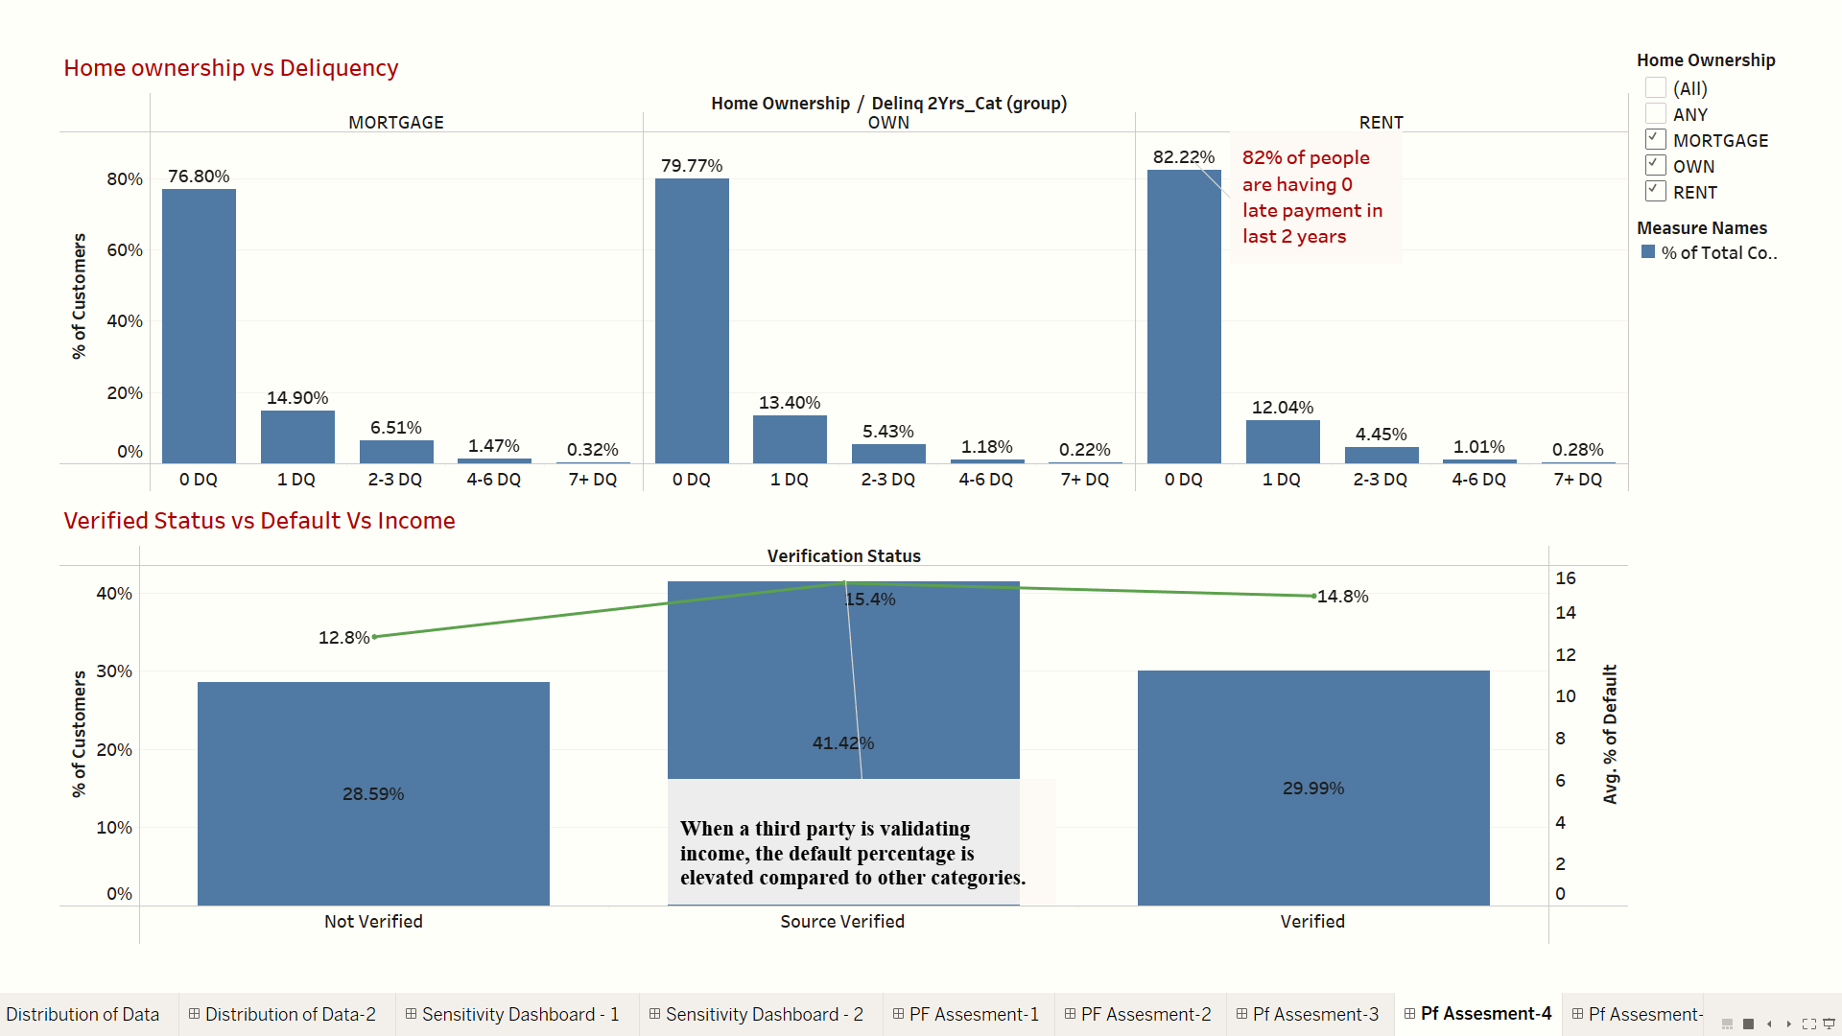
Portfolio Health Check: Evaluating Quality and Performance Metrics

Slide 15
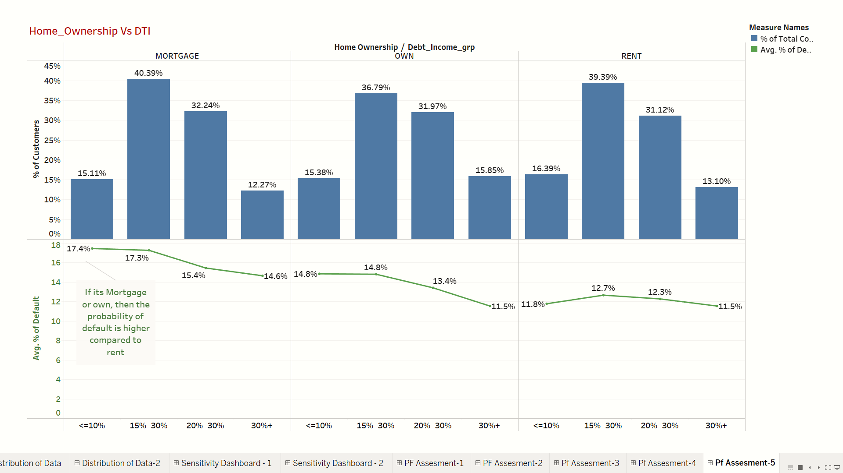
Portfolio Health Check: Evaluating Quality and Performance Metrics

Slide 16
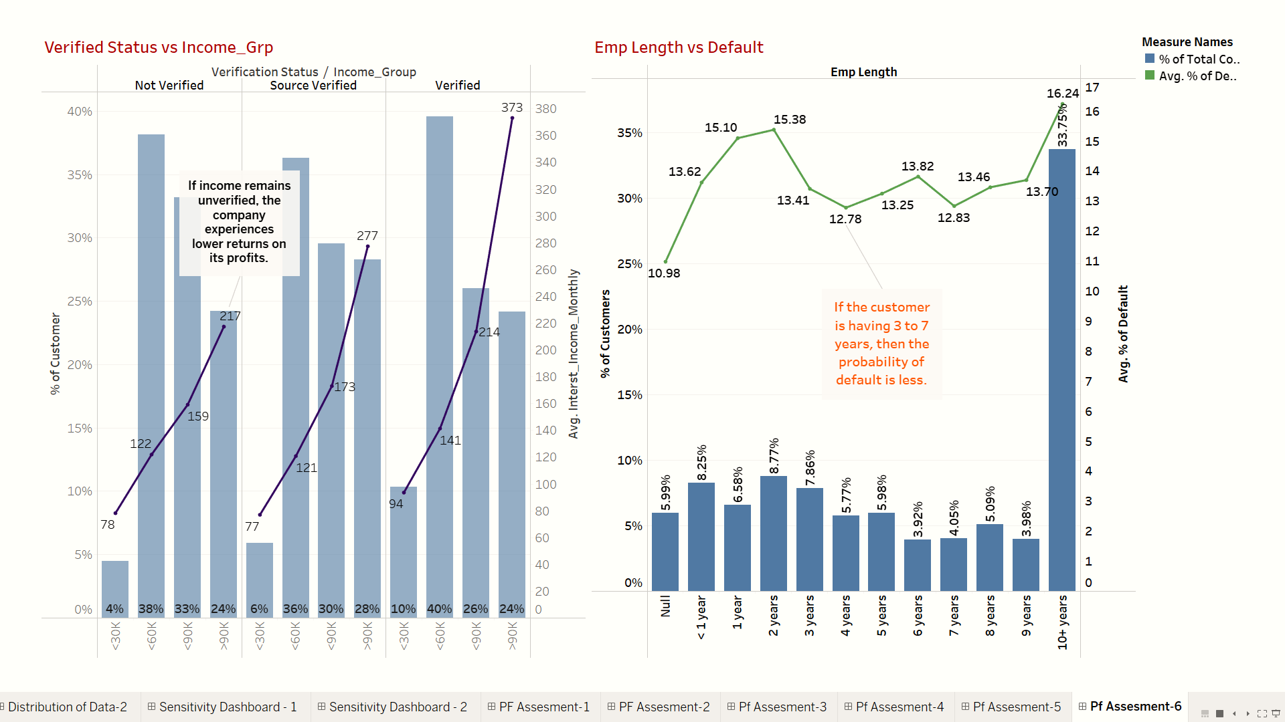
Portfolio Health Check: Evaluating Quality and Performance Metrics

Slide 17
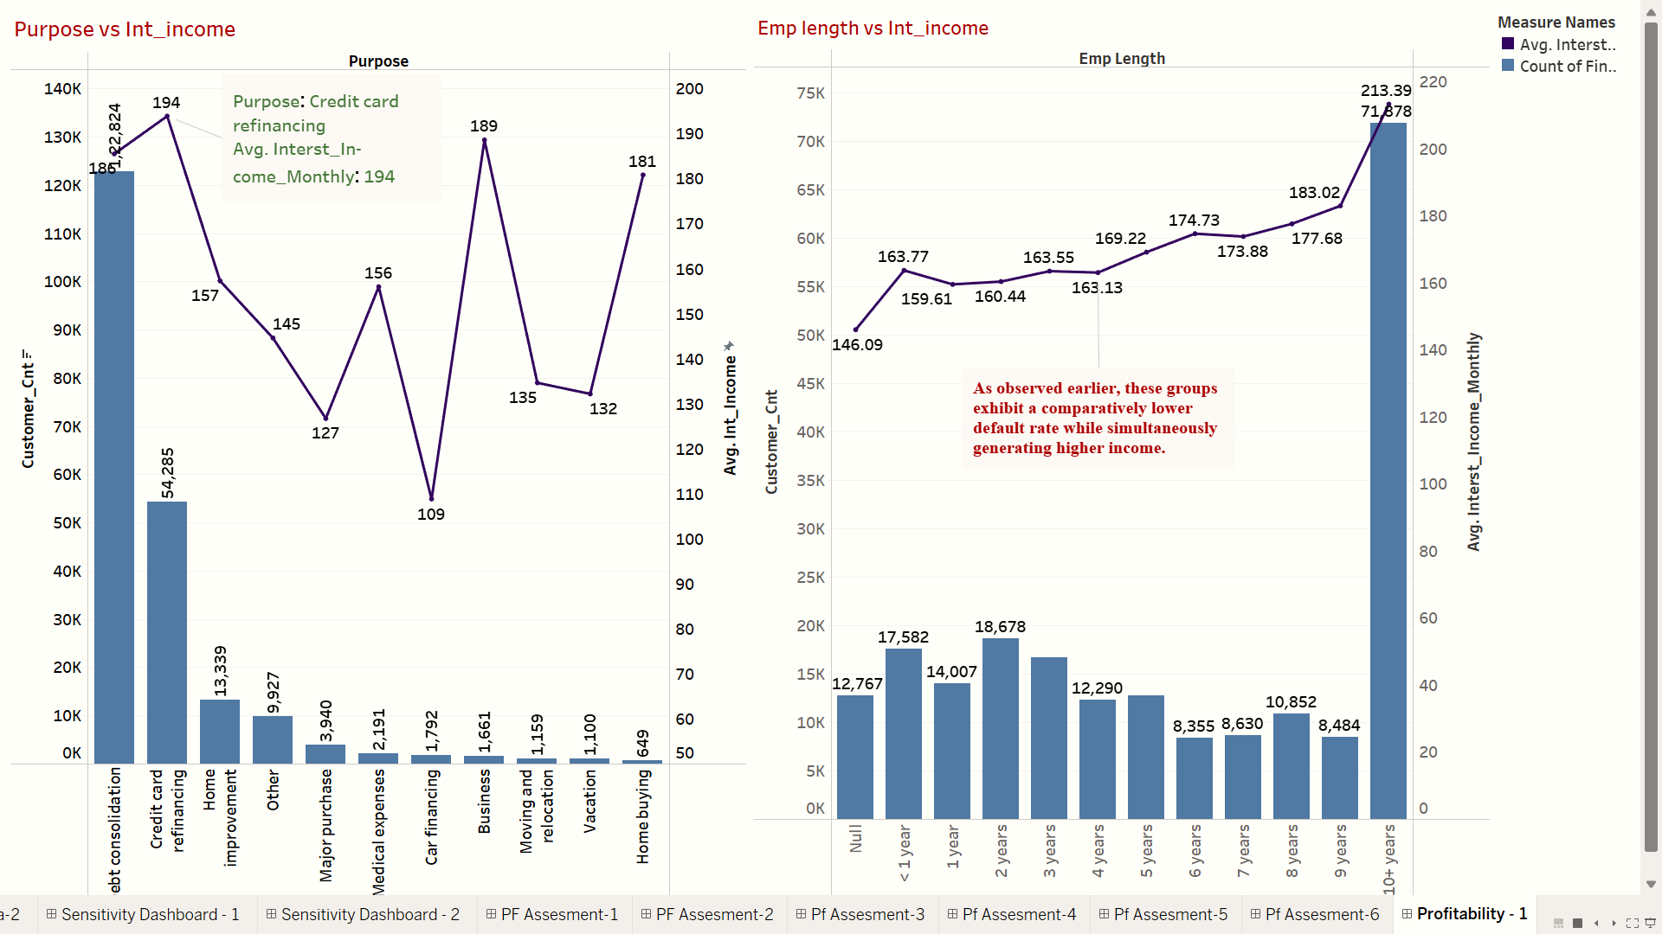
Driving Profitability: Key Insights from Portfolio Performance Analysis

Slide 18
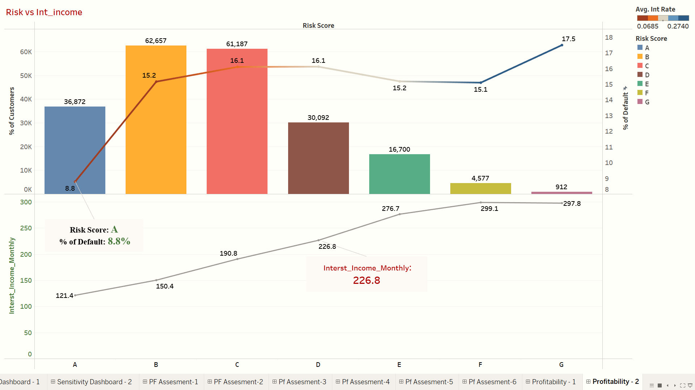
Driving Profitability: Key Insights from Portfolio Performance Analysis

Slide 19
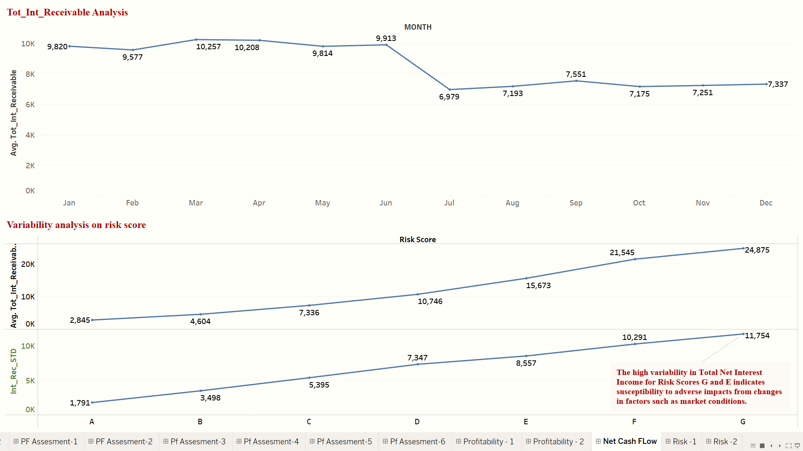
Projected Net Credit Margin Analysis: Optimizing Profitability with 8% Cost of Funds
Net Credit Margin = 0.21%
Average Total Interest Income: 7268

Slide 20

Strategic Loan Portfolio Optimization : Enhancing Financial Performance
Enhancing the company's profitability is achievable by strategically increasing financing for Business Loans among individuals earning over 90k, leveraging their higher financial capacity.
Capitalizing on the minimal default rates observed in the last two years, a targeted approach to expand credit card financing among individuals earning less than 30k especially for Risk A Customers will contribute positively to overall profitability.
Despite similar default scores, Risk D customers exhibit higher interest income compared to B and C, suggesting an opportunity to increase financing for Risk D individuals with salaries exceeding 30k in categories like Business Loans, Home Improvement, Home Buying, and Credit Card Financing.
Identifying an optimal target group for increased credit card financing includes individuals with professional experience ranging from 3 to 7 years.
Simultaneously, focusing on expanding Business Loans should prioritize applicants earning over 90k to ensure higher financial stability.
Note: Car financing and vacation loans exhibit lower profitability, and without historical or monthly data, adjustments can't be made. To optimize, prioritize verifying income for individuals earning over 60k.

Slide 21
Critical Information Needs for Informed Decision-Making
Loan Funding Year
Month on Book
Payment Status for the Present Month
Interest Type
Require demographic data to assess the regional or area-level performance of the portfolio.
Dates of charged-off accounts
Pattern of Delinquency Both Within and Outside the Company
Number of Loans External to the Company
Requiring details on additional loans taken within the company for reconciliation.
Remaining Repayment Period
historical data for analyzing seasonality or trends

Slide 22
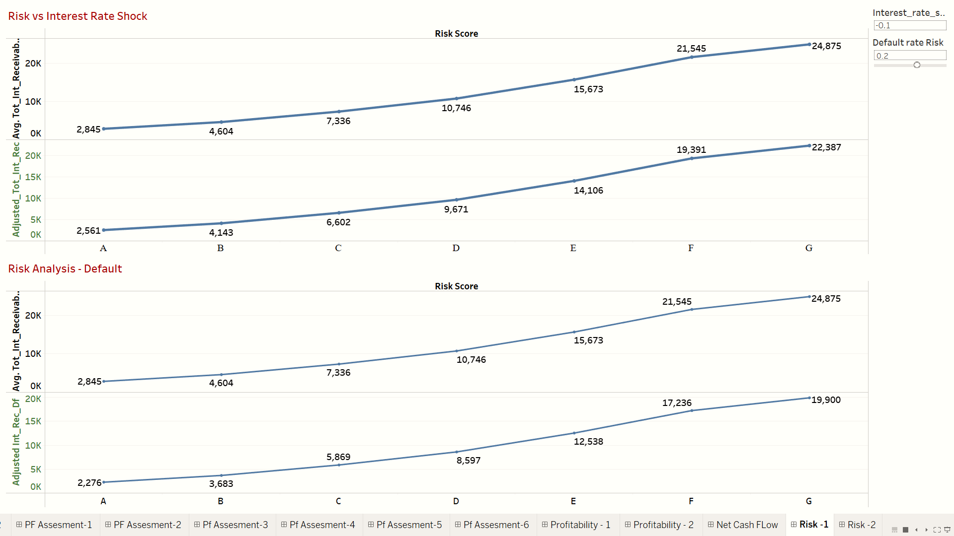
Market Condition Sensitivity Analysis: Adapting the Portfolio to Dynamic Environments
Interest Rate Shock: Setting the risk at 10% in response to the decrease in market interest rates reveals that Risk A, B and C remain unaffected adversely.
Fluctuation in Default Rate: As mentioned earlier, when assuming a 20% increase in default rate from the current average, Risk A exhibits minimal change.

Slide 23
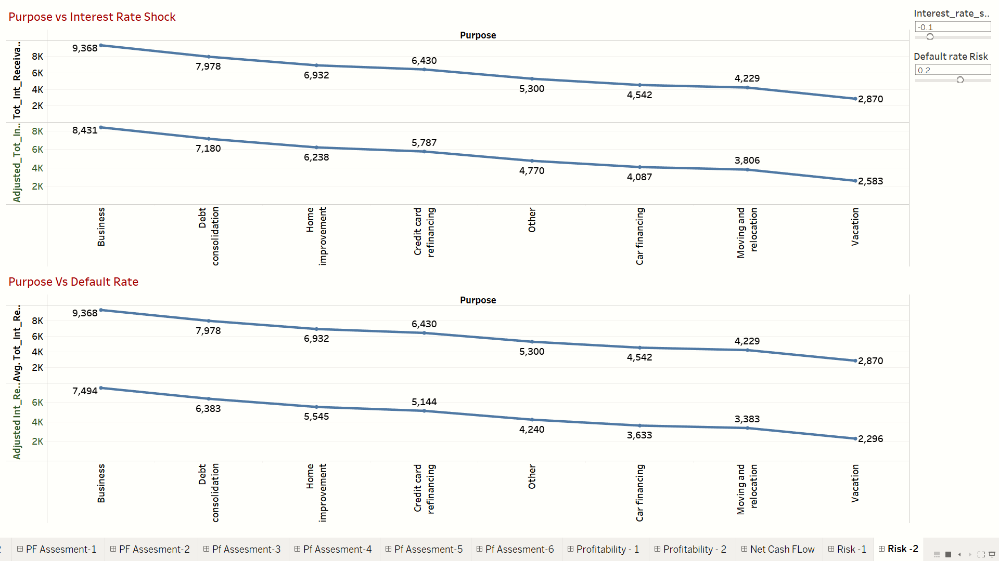
Market Condition Sensitivity Analysis: Adapting the Portfolio to Dynamic Environments
Notwithstanding the fluctuations in market interest rates, both credit card financing and Business loans generating a High Income to the company.
Allocating more loans towards these purposes is a strategic move that can significantly contribute to optimizing the company's portfolio.

Slide 24

Risk Assessment: Identifying Key Factors Impacting Forecasted Performance
Limited Historical Data:
Risk: The absence of detailed month-on-month data and on-book details of customers limits our ability to conduct a granular historical performance analysis.
2. Assumption Sensitivity:
Risk: The forecast heavily relies on certain assumptions, such as the linear distribution of losses and stable economic conditions.
3. Portfolio Quality Assumptions:
Risk: The assessment of portfolio quality is based on limited available information. Inaccurate assumptions about borrower creditworthiness, loan terms, and overall portfolio health may result in an overestimation or underestimation of the net credit margin.
4. Repayment Behavior Uncertainty:
Risk: Lack of detailed month-on-month data makes it challenging to accurately predict borrower repayment behavior.
5. Portfolio Optimization Challenges:
Risk: Implementing recommended strategies for portfolio optimization may face challenges, such as identifying and executing on underperforming assets, restructuring loans, or entering new markets.

Slide 25
Thank You

